Slide 1
ALPHANOV
Laser Fault Injection solutions
CASCADE, 04/25
N. Falletto

Slide 2

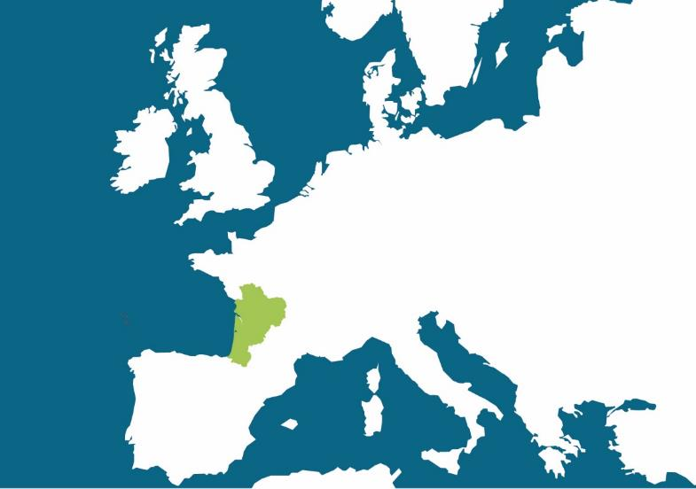







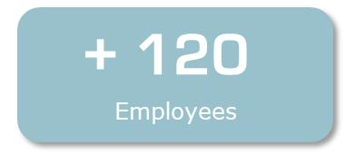
Locations
Limoges Office
Since 2018
Institut d’Optique d’Aquitaine - Bordeaux
ALPhANOV is located in “Institut d’Optique d’Aquitaine”, on the Bordeaux University campus.
Non-profit organization founded in 2007
RTO, Research and Technology Organization

Slide 3

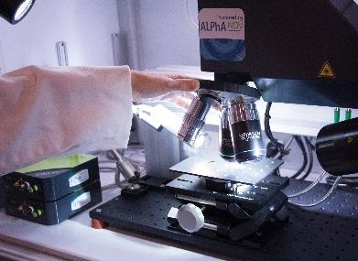
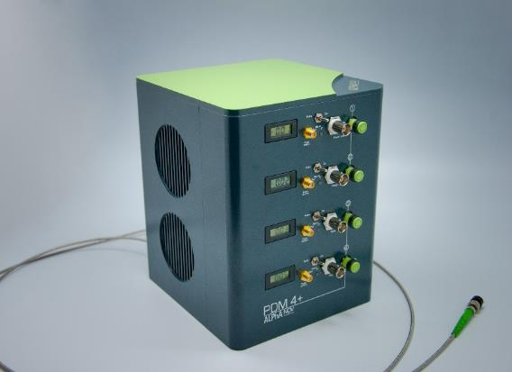
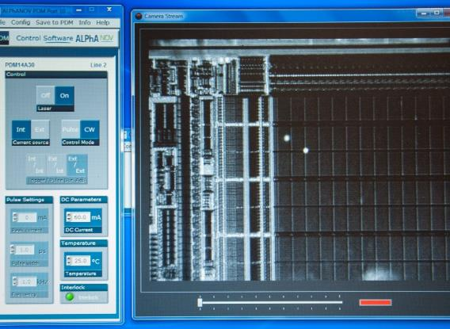
ALPHANOV chip security testing
using lasers and systems expertise for hardware design and manufacturing
Standard and customized solutions including scanner beam deliveries
partnership with for advanced software solutions (3km away)
Design and manufacturing of microscope systems for printed circuit boards testing (single, double, quadruple fault injection)
Photoemission circuit imaging
Laser sources suitable for circuit testing (PDM: Pulse on Demand Module, Picosecond, Femtosecond)
Thermal Laser Stimulation
Notes:
1ère photo : banc laser d’injection de faute à deux spots simultanés dans le microscope
2ème photo : PDM – Pulse on-demand module : Source laser à diode permettant de générer des pulses à la demande de 1ns au CW avec une très forte précision temporelle
3ème photo : Vue des spots laser sur un circuit intégré via la face arrière (à travers le silicium) grâce à de l’imagerie IR

Slide 4
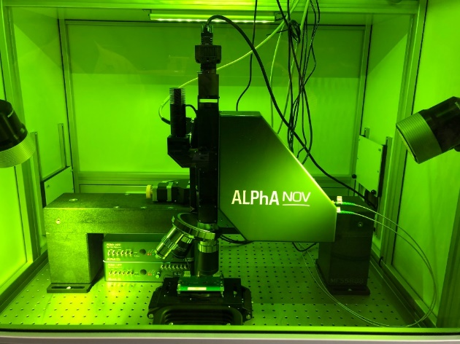
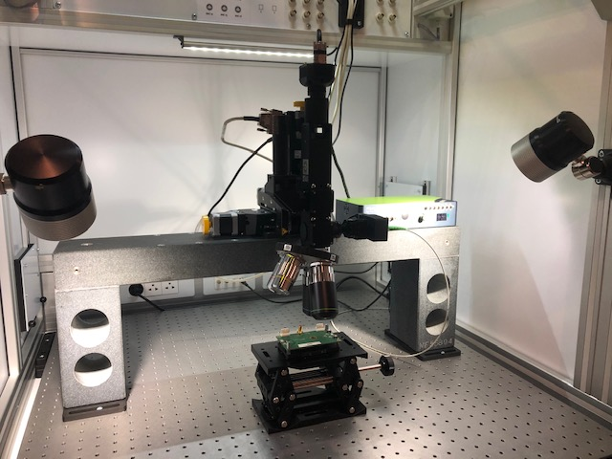
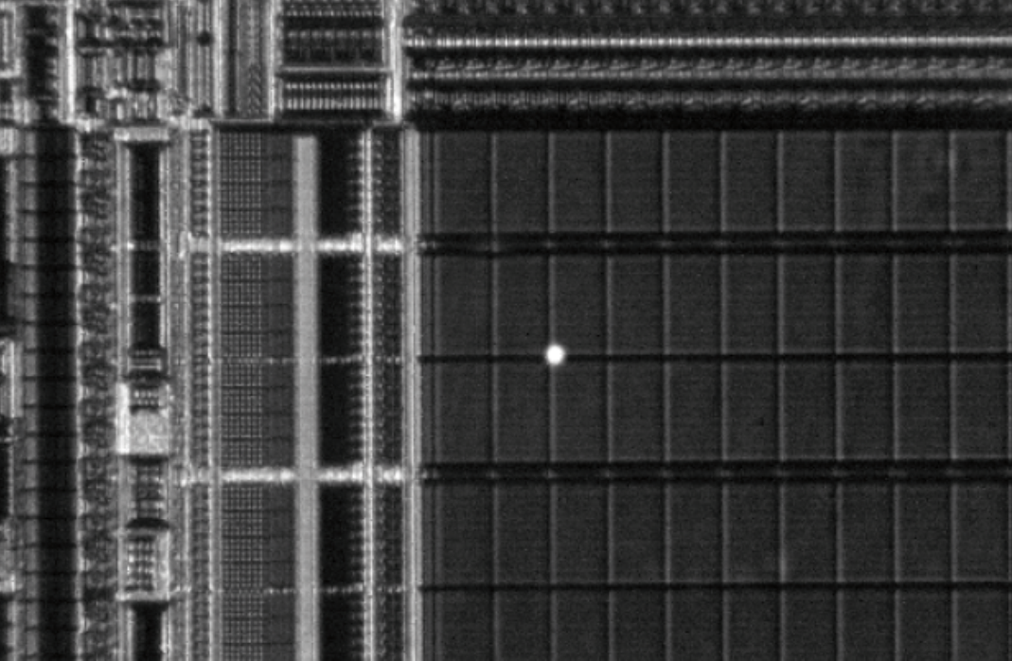
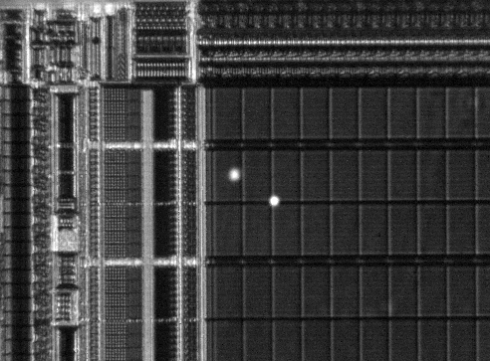
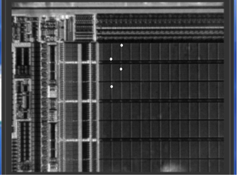
S/D/Q-LMS – Single/Double/x4 Laser Microscope Station
The microscope allows to inject 1, 2 or 4 single-mode laser spot(s) through the same objective. For the D/Q-LMS, the spots can be moved independently in the field.
Coupled with an IR camera it allows to see at the same time the layout through the silicon and the laser beams
View of the Chip and the laser spot from the back side

Slide 5
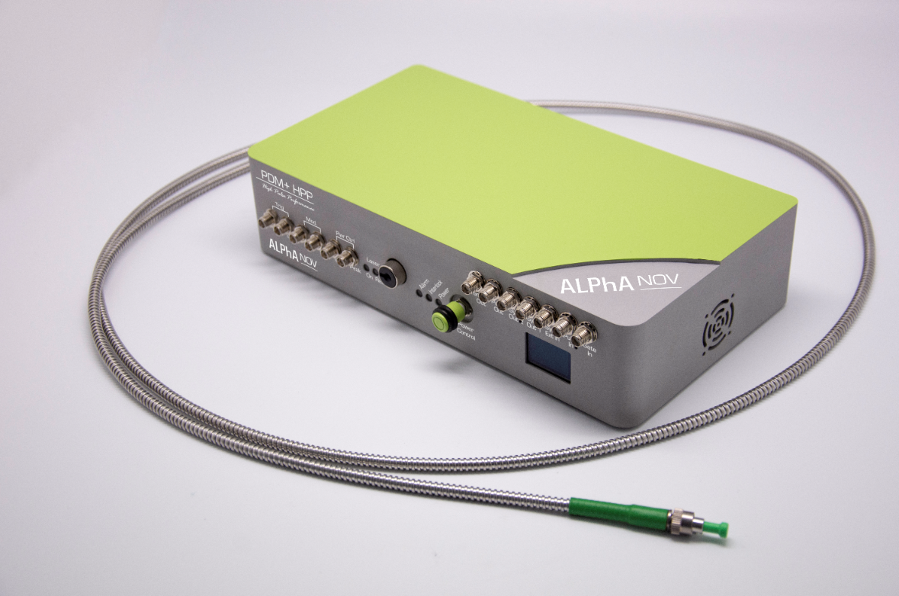
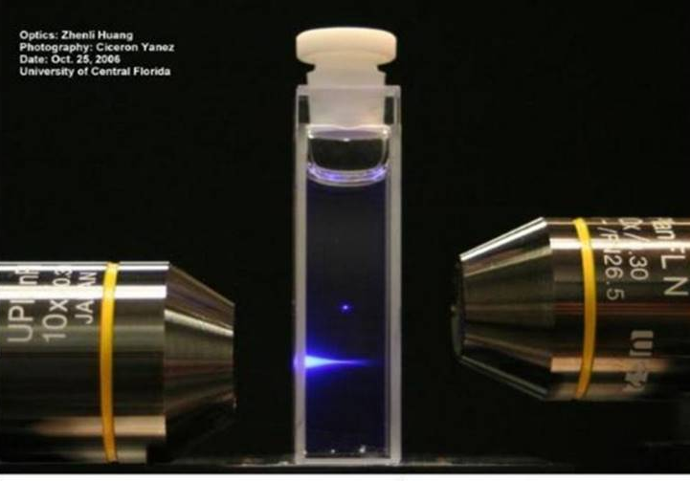
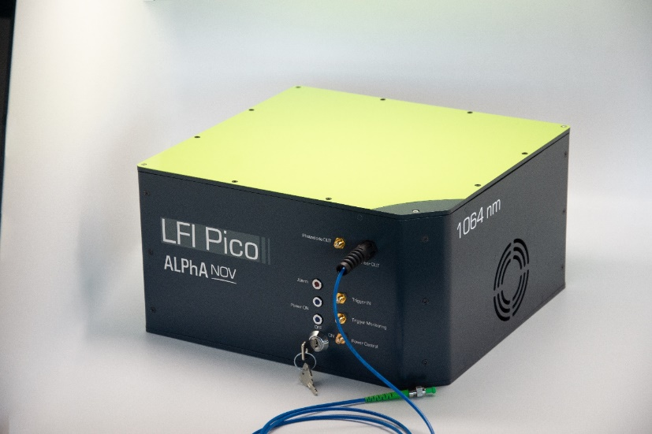
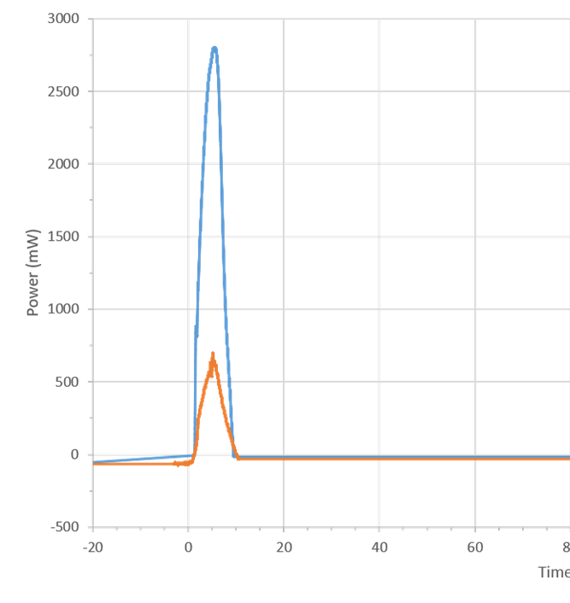
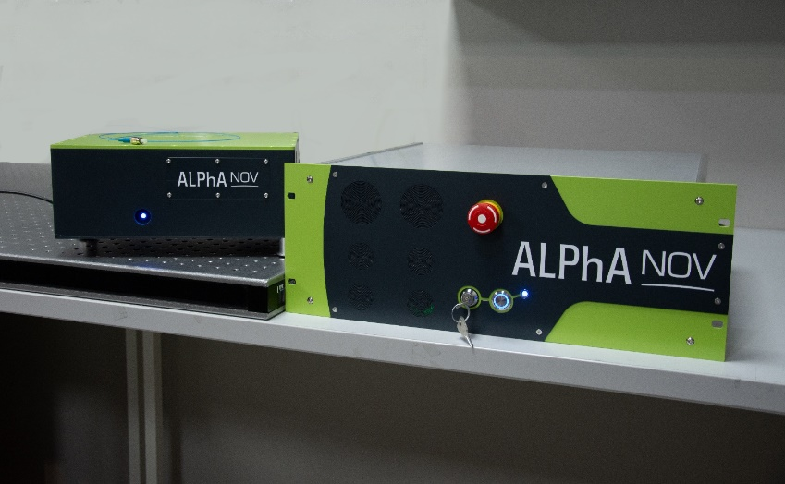
Lasers solutions
All sources are single mode for smallest spot size
Picosecond
Non Linear absorption
Linear absorption
Femtosecond
More confined charges generation
Faster deposition of energy
Nanosecond
State of the art
Optimized jitter and transients

Slide 6
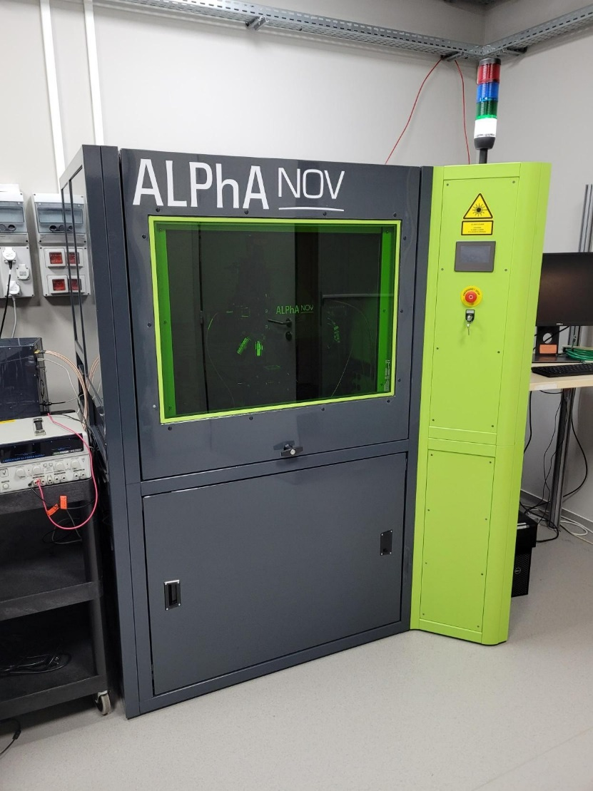
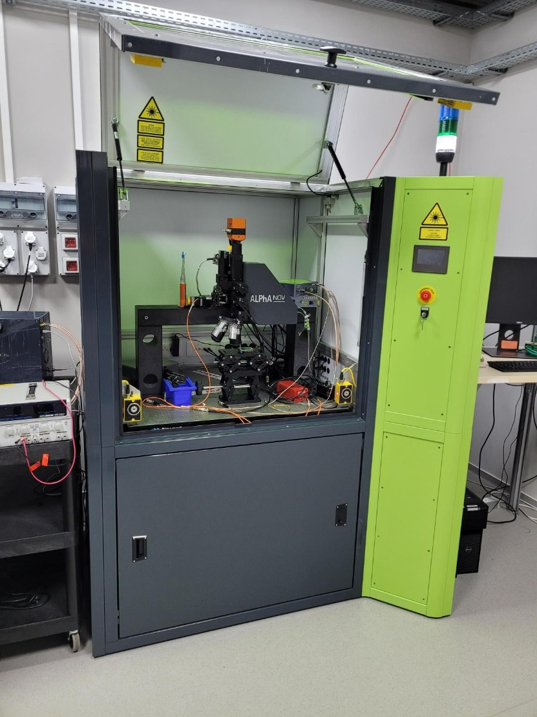
Alphanov services : demo lab
For proof of concept tests with laser sources and/or specific options (photoemission cameras, photon detector, esDynamics, TLS, Femto, Pico, PDMs, Decaps)

Slide 7
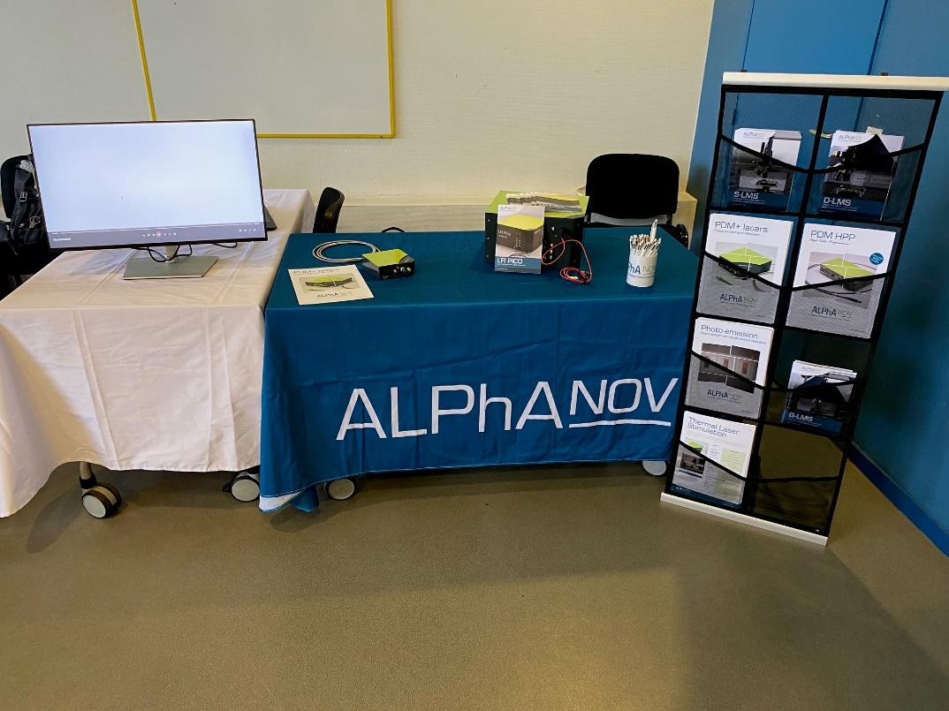
Meet us at our booth
Picosecond and PDM demo lasers
presented
Nicolas Falletto – Product Manager – nicolas.falletto@alphanov.com - +33658991034

Slide 8
Thank you for your attention

